Slide 1
World Development Indicators
Team 6
- Priyal Chaudhari
- Prashant Vikram Singh
- Under the guidance of Prof. Srikanth Krishnamurthy

Slide 2
Dataset Description
Dataset Description
Link: http://data.worldbank.org/data-catalog/world-development-indicators
Description:
This dataset contains time series data for all economic indicators and countries listed below:
Countries:
- Argentina
- Brazil
- India
- Ecuador
2. Economic Indicators:
- GDP Growth
- Birthrate
- Agriculture
- Population Growth
- Age Dependency Ratio
The data is available in yearly format from 1960 till 2016 for all the indicators.

Slide 3
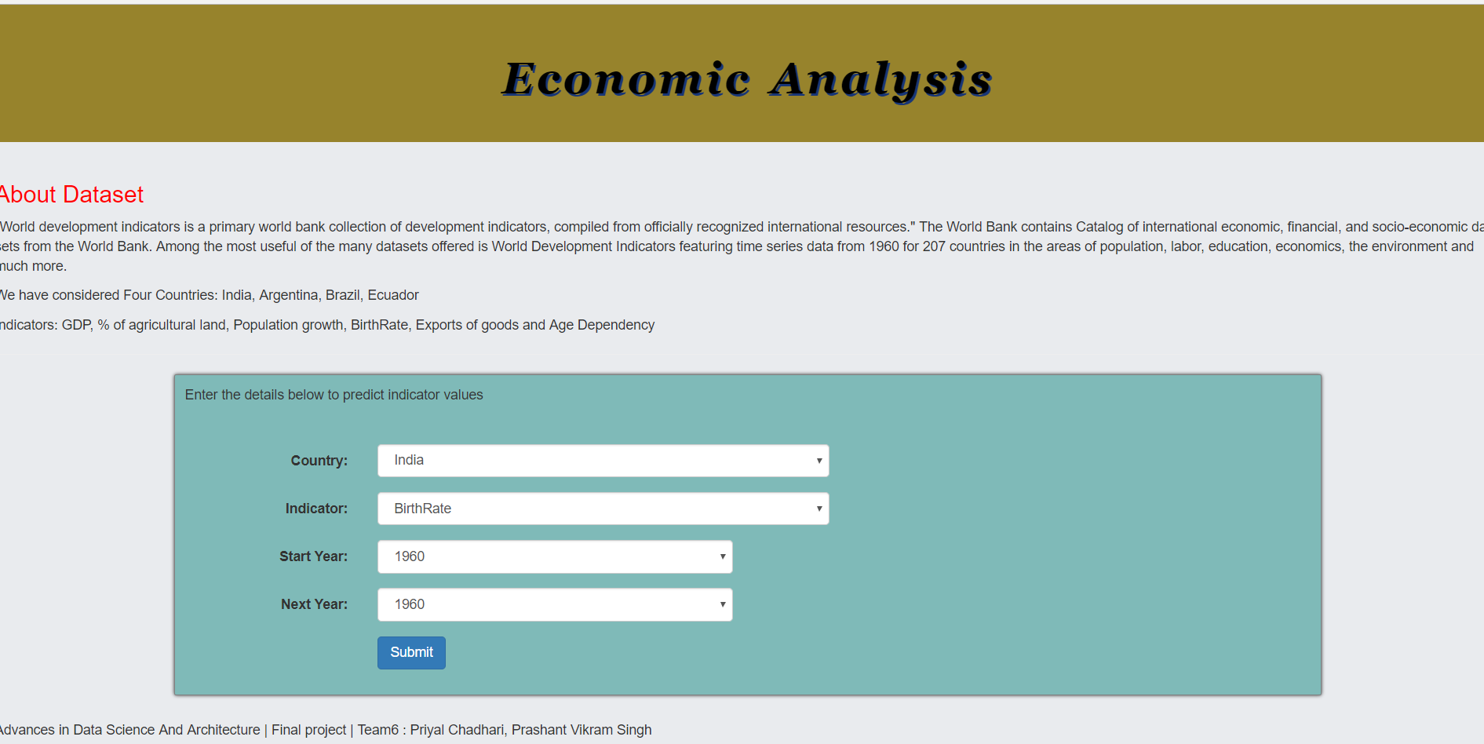
Web App Page 1

Slide 4
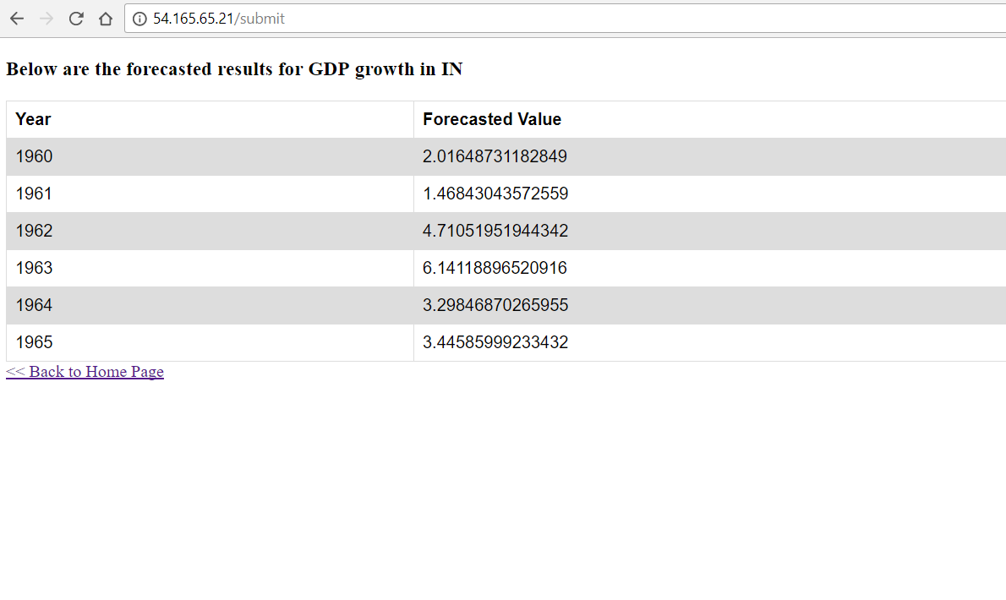
Web App Page 2

Slide 5
Types of time series data modeling
Following are the ways based on which we can build regression models on time series data:
Univariate : The future values of variable depends on its previous values
Multivariate: The values of dependent variable depend on its previous values as well as values of other variables in the dataset
Here we have restricted our analysis to univariate analysis but built a base for multivariate analysis.

Slide 6
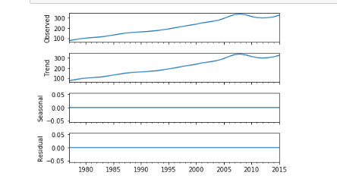
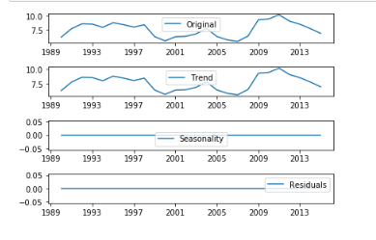
Decomposition of Time Series
Definition: The decomposition of time series is a statistical method that deconstructs a time series into several components, each representing one of the underlying categories of patterns.
We have decomposed all the time series based on rates of change.
Following are the components into which a time series is decomposed:
1. Trend: A trend exists when there is an increasing or decreasing direction in the data
2. Cyclical: describes repeated but non-periodic fluctuations
3. Seasonal: A seasonal pattern exists when a time series is influenced by seasonal factors
4. Noise: describes random, irregular influences; represents the residuals or remainder of the time series
Our time series decomposition examples:

Slide 7
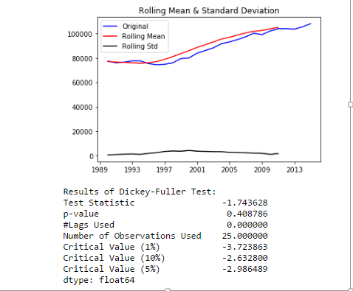
Stationarity Check
Time series data varies over a period of time and is not stationary (constant).
Hence, it may become difficult to build perfect models and predict values using such type of data.
As a result, we can perform following techniques to stationarize the data:
Log transformation
Differencing
Log + Differencing
We can check if the time series is stationary from following techniques:
Constant Mean and Variance
Test statistic of Dickey-Fuller test
Below is our original data graph which also contains mean and variance metrics alognwith the adfuller test results:

Slide 8
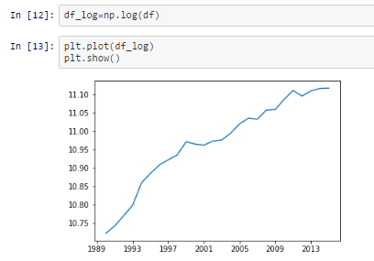
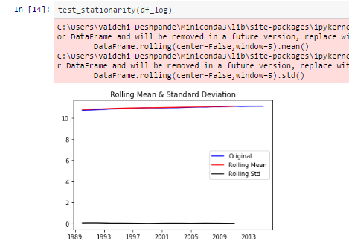
Stationarity Check Contd…
Since our original data is clearly not stationary, we have taken log transformation and again validated by plotting mean and variance:
As per above graphs it is clear that the mean and variance are almost constant over a period of time which implies that our time series is now stationary.
We can now go ahead and build models using the log transformed time series
Once the models are built and values are predicted we can boost the result to original scale by using numpy.exp() function

Slide 9
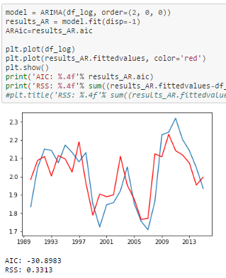
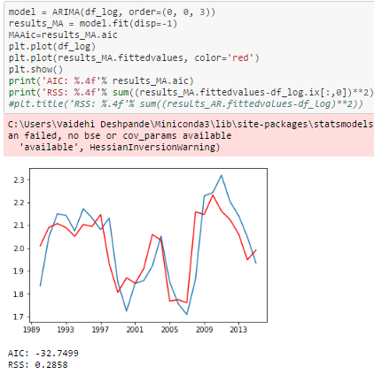
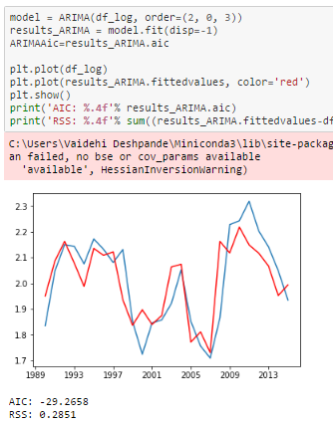
Building AR, MA and ARMA models
An autoregressive model is when a value from a time series is regressed on previous values from that same time series.
In addition to AR, we also have Moving Average (MA) models and a combination of both ARMA and ARIMA models. The predictors depend on the parameters (p,d,q) of the ARIMA model:
Number of AR (Auto-Regressive) terms (p): AR terms are just lags of dependent variable. For instance if p is 5, the predictors for x(t) will be x(t-1)….x(t-5).
Number of MA (Moving Average) terms (q): MA terms are lagged forecast errors in prediction equation. For instance if q is 5, the predictors for x(t) will be e(t-1)….e(t-5) where e(i) is the difference between the moving average at ith instant and actual value.
Number of Differences (d): These are the number of non seasonal differences, i.e. in case we take the first order difference we can pass the differenced variable and put d=0 or pass the original variable and put d=1. Both will generate same results
Examples of models created:

Slide 10
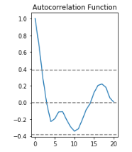
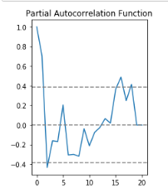
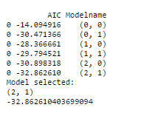
AIC, ACF and PACF
AIC:
Definition: The Akaike information criterion (AIC) is a measure of the relative quality of statistical models for a given set of data. Given a collection of models for the data, AIC estimates the quality of each model, relative to each of the other models.
Hence, AIC provides a means for best model selection. The lower the AIC better is the model
Here we have created a matrix containing model values and AIC measure and then have chosen the best model based which has lowest AIC value.
Autocorrelation Function (ACF):
Definition: It is a measure of the correlation between the TS with a lagged version of itself. For instance at lag 5, ACF would compare series at time instant ‘t1’…’t2’ with series at instant ‘t1-5’…’t2-5’ (t1-5 and t2 being end points).
Partial Autocorrelation Function (PACF):
Definition: This measures the correlation between the TS with a lagged version of itself but after eliminating the variations already explained by the intervening comparisons. Eg at lag 5, it will check the correlation but remove the effects already explained by lags 1 to 4.
Below are screenshots of AIC matrix, ACF and PAF plots as an example:

Slide 11
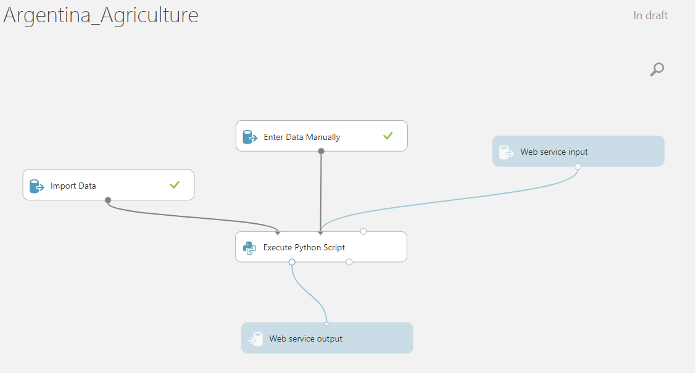
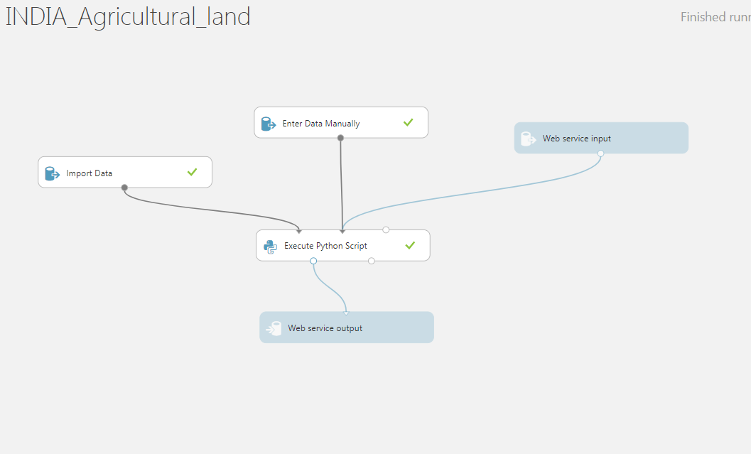
Azure Model
After choosing the best model we have deployed it further in azure machine learning studio
We have created one model for each indicator for each country and then created REST APIs for that
Below is the sample model created in azure:

Slide 12
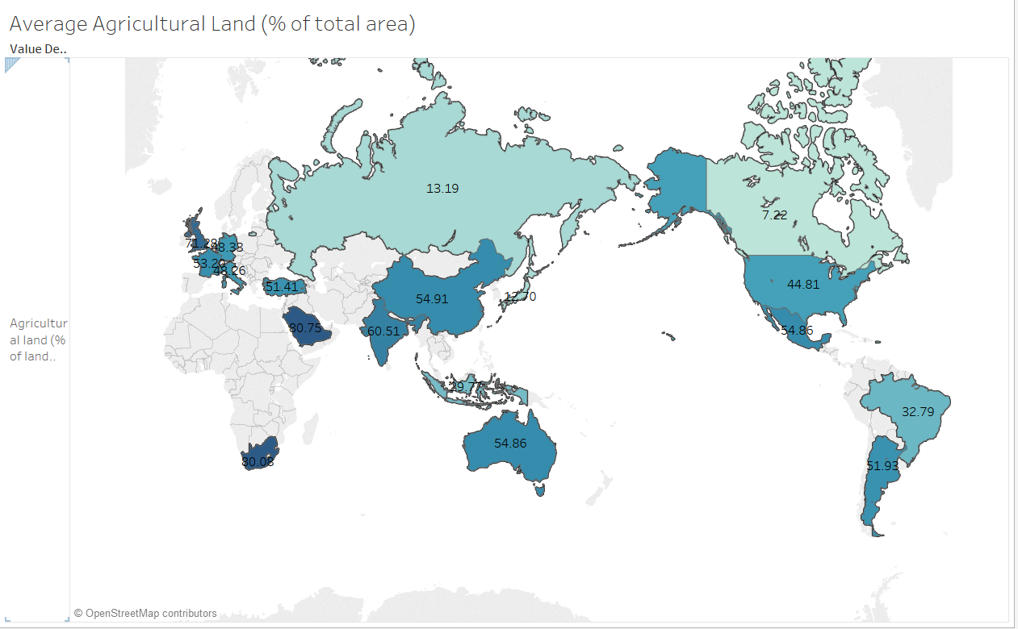
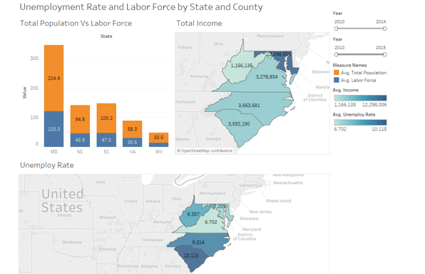
Exploratory Data Analysis
Compare different countries based on Agricultural Land

Slide 13
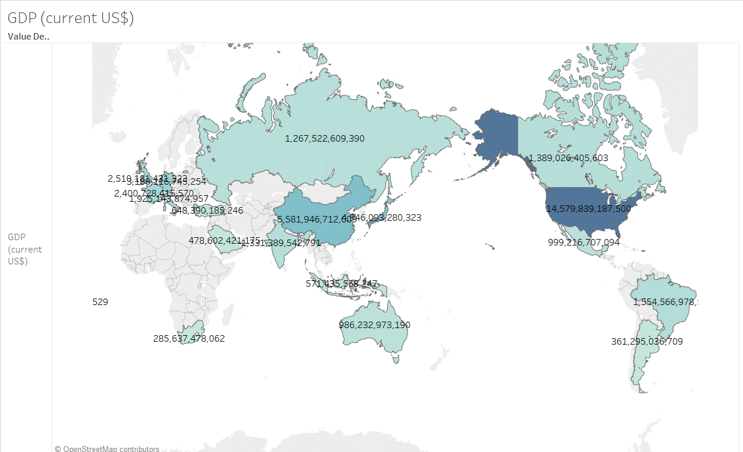
Exploratory Data Analysis
Compare different countries based on GDP

Slide 14
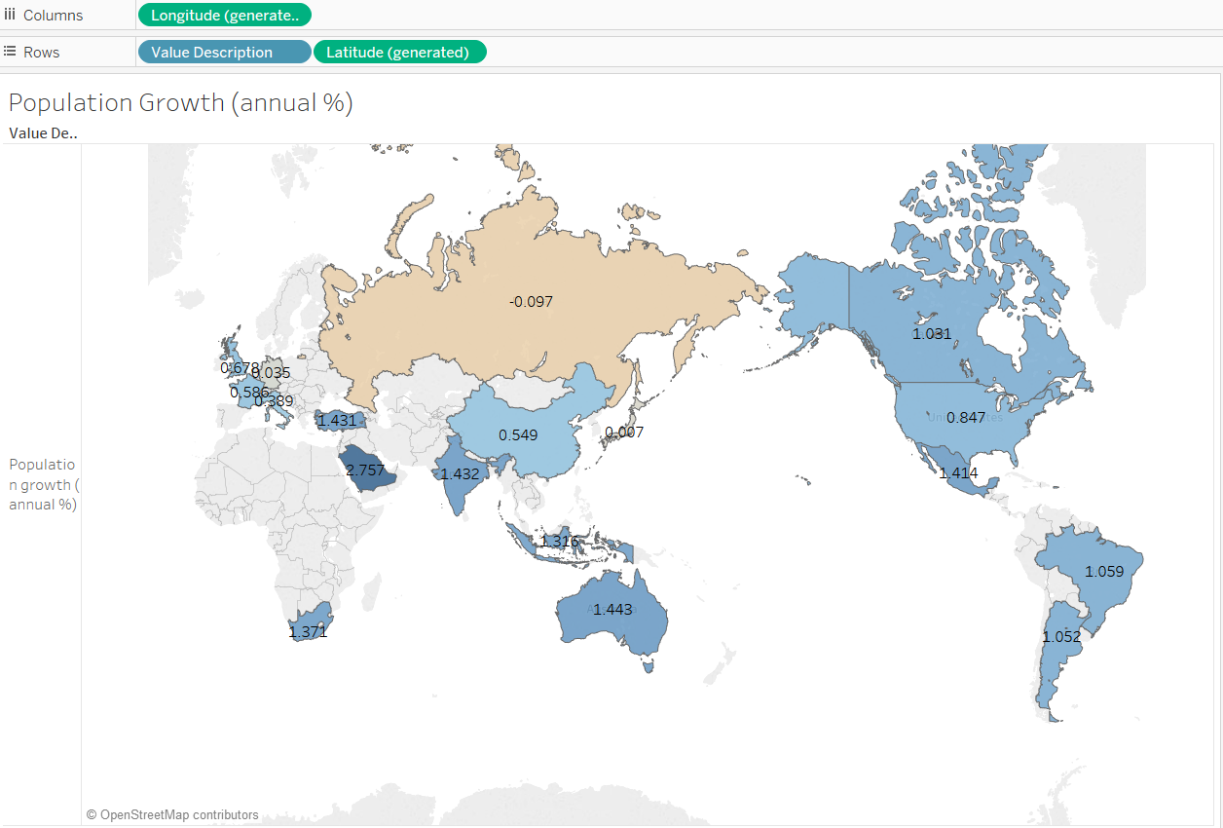
Exploratory Data Analysis
Compare different countries based on Population Growth

Slide 15
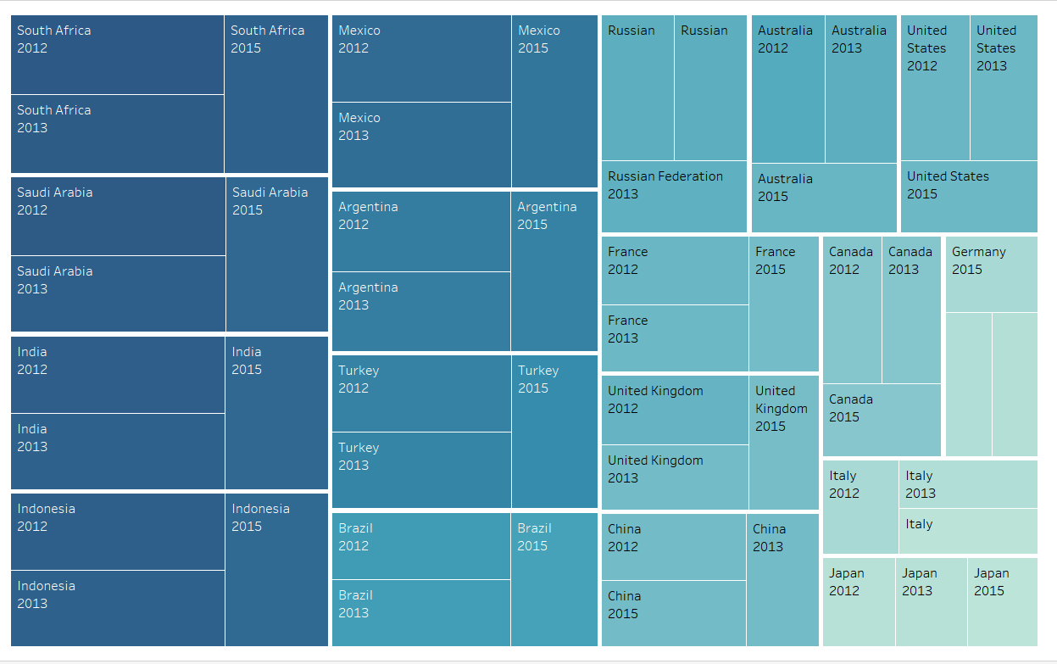
Exploratory Data Analysis Contd..
Compare birth rate for all countries:

Slide 16
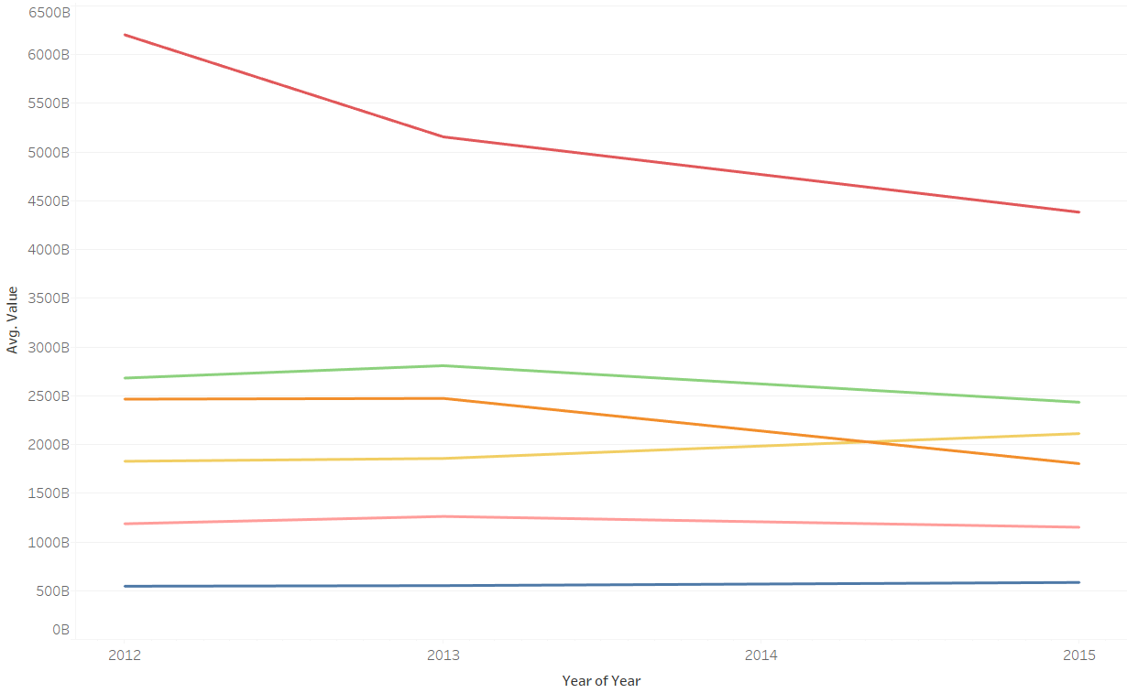
Exploratory Data Analysis Contd..
GDP trends over the years

Slide 17
References
https://www.analyticsvidhya.com/blog/2016/02/time-series-forecasting-codes-python/
http://machinelearningmastery.com/model-residual-errors-correct-time-series-forecasts-python/
http://www.statsmodels.org/dev/generated/statsmodels.tsa.arima_model.ARIMA.fit.html
http://www.statsmodels.org/stable/generated/statsmodels.tsa.statespace.sarimax.SARIMAX.html

Slide 18
Pie Chart

Slide 19
THANK YOU!!

